Slide 1
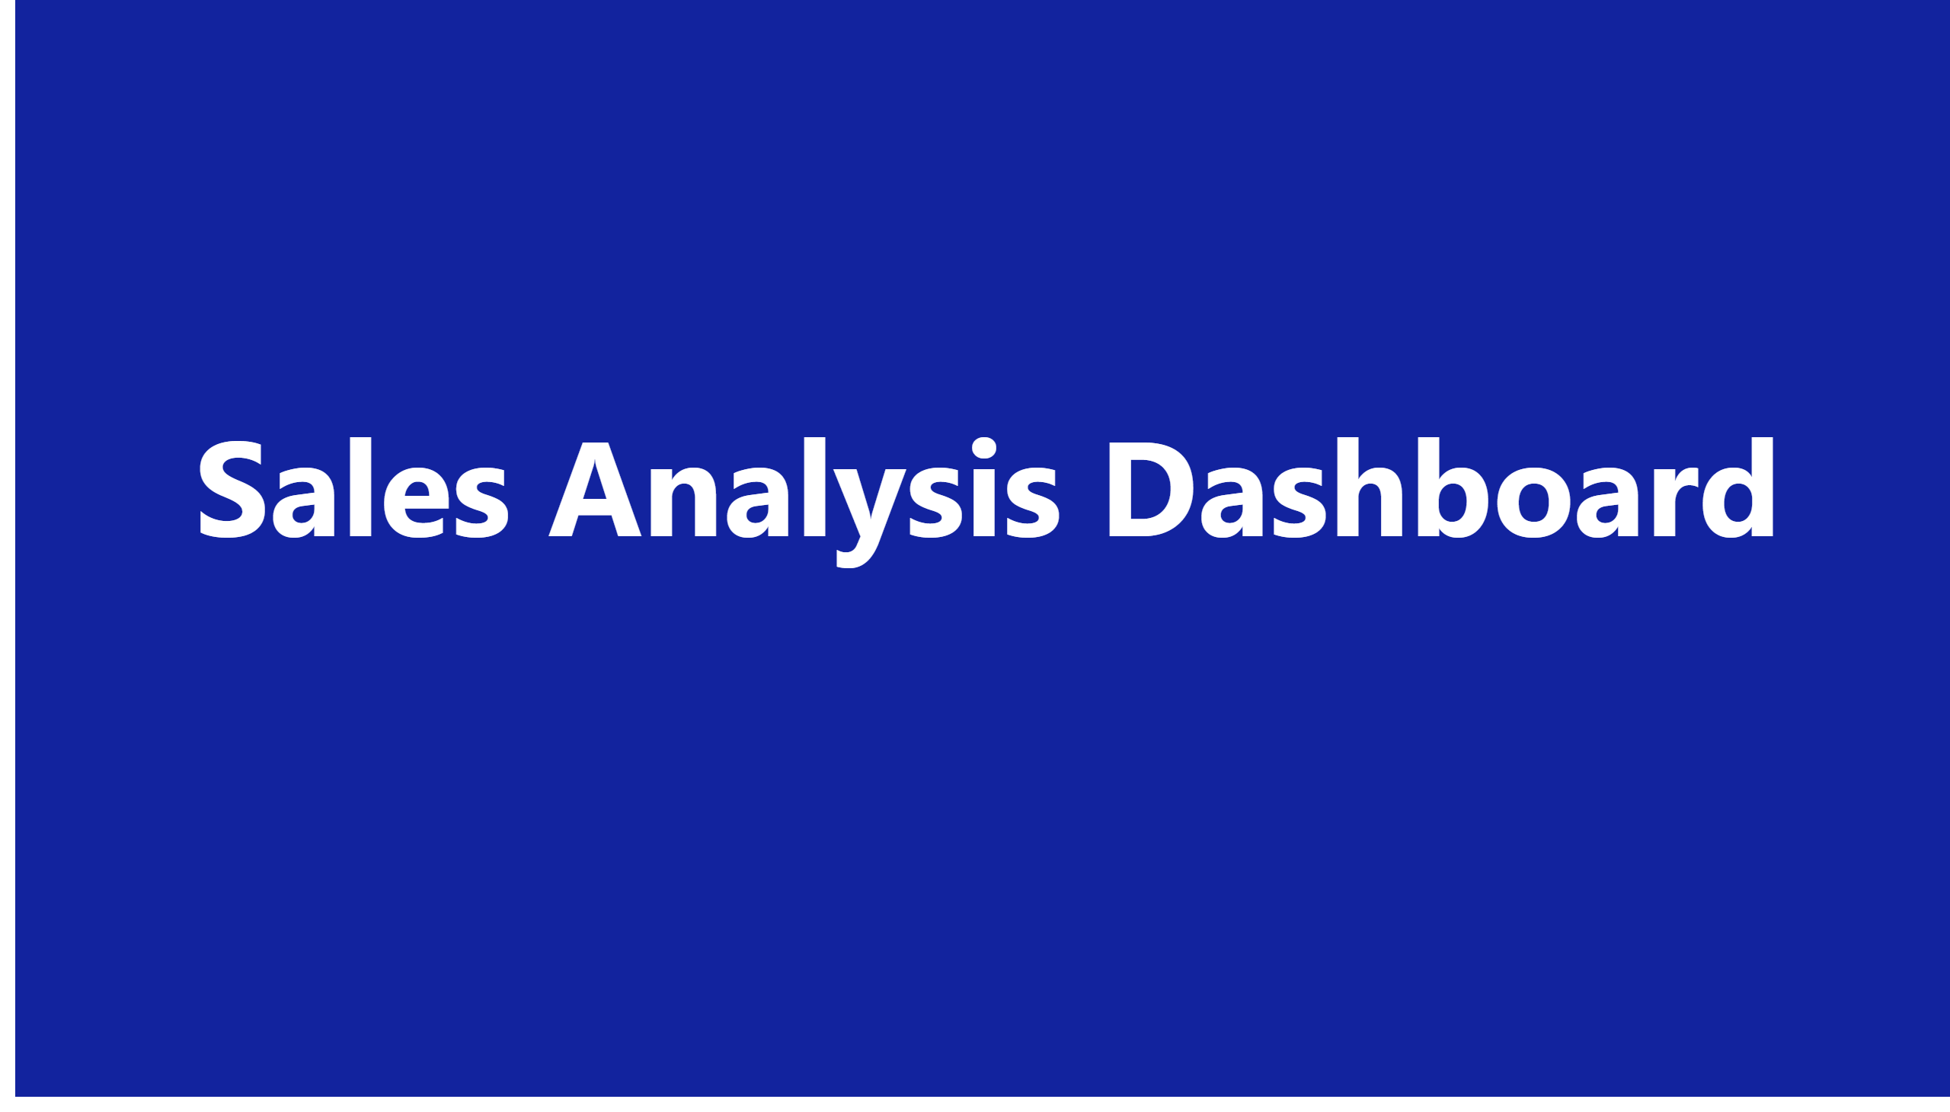
Page 1
Notes:
textbox
No alt text provided

Slide 2
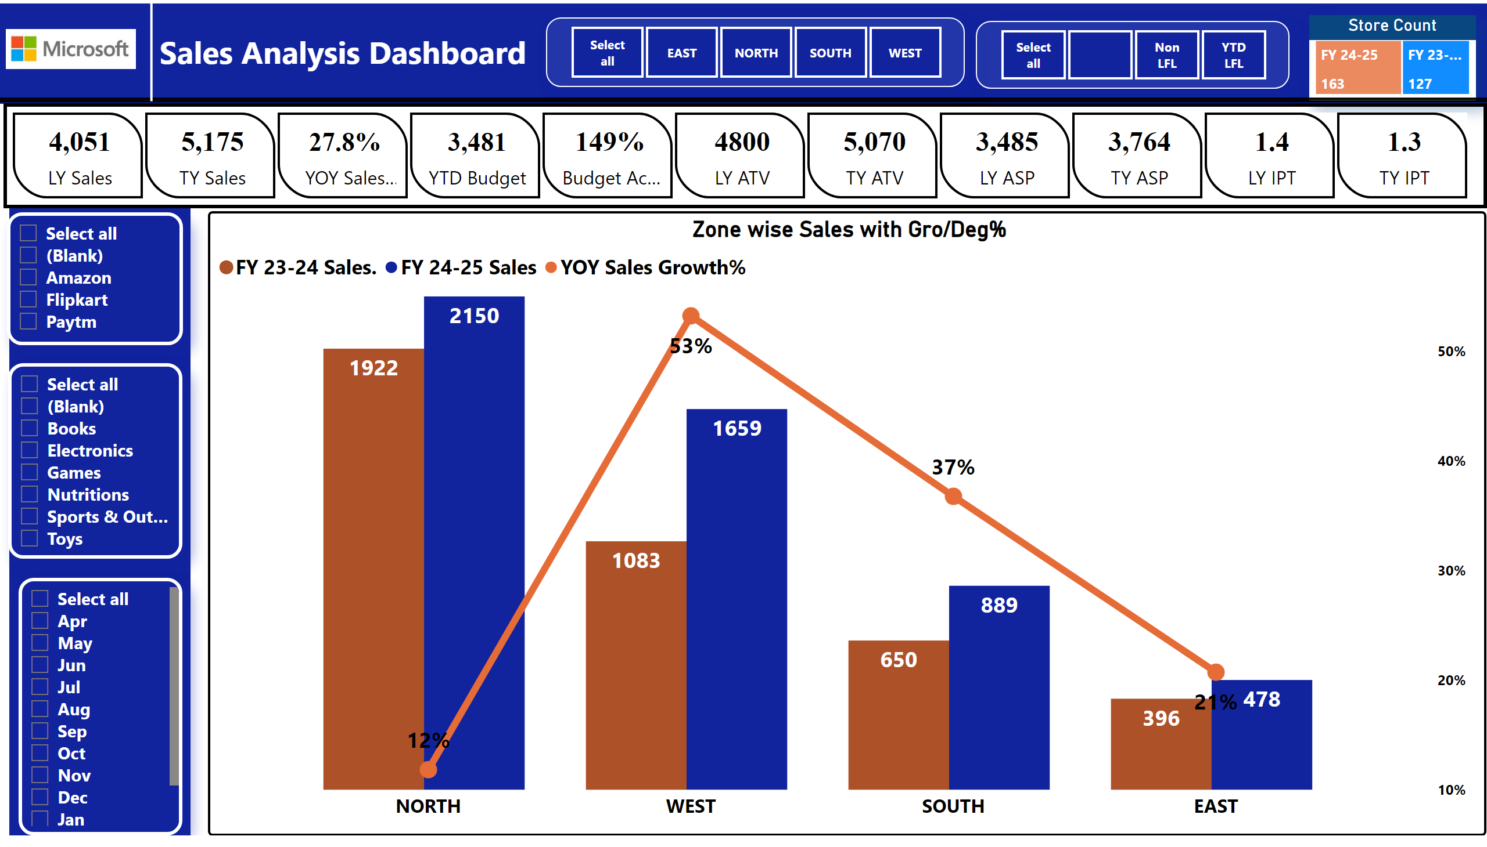
Zone wise Perfomence
Notes:
slicer
No alt text provided
Store Count
No alt text provided
slicer
No alt text provided
slicer
No alt text provided
slicer
No alt text provided
slicer
No alt text provided
cardVisual
No alt text provided
Zone wise Sales with Gro/Deg%
No alt text provided
shape
No alt text provided
shape
No alt text provided
shape
No alt text provided
textbox
No alt text provided
textbox
No alt text provided
image
No alt text provided

Slide 3
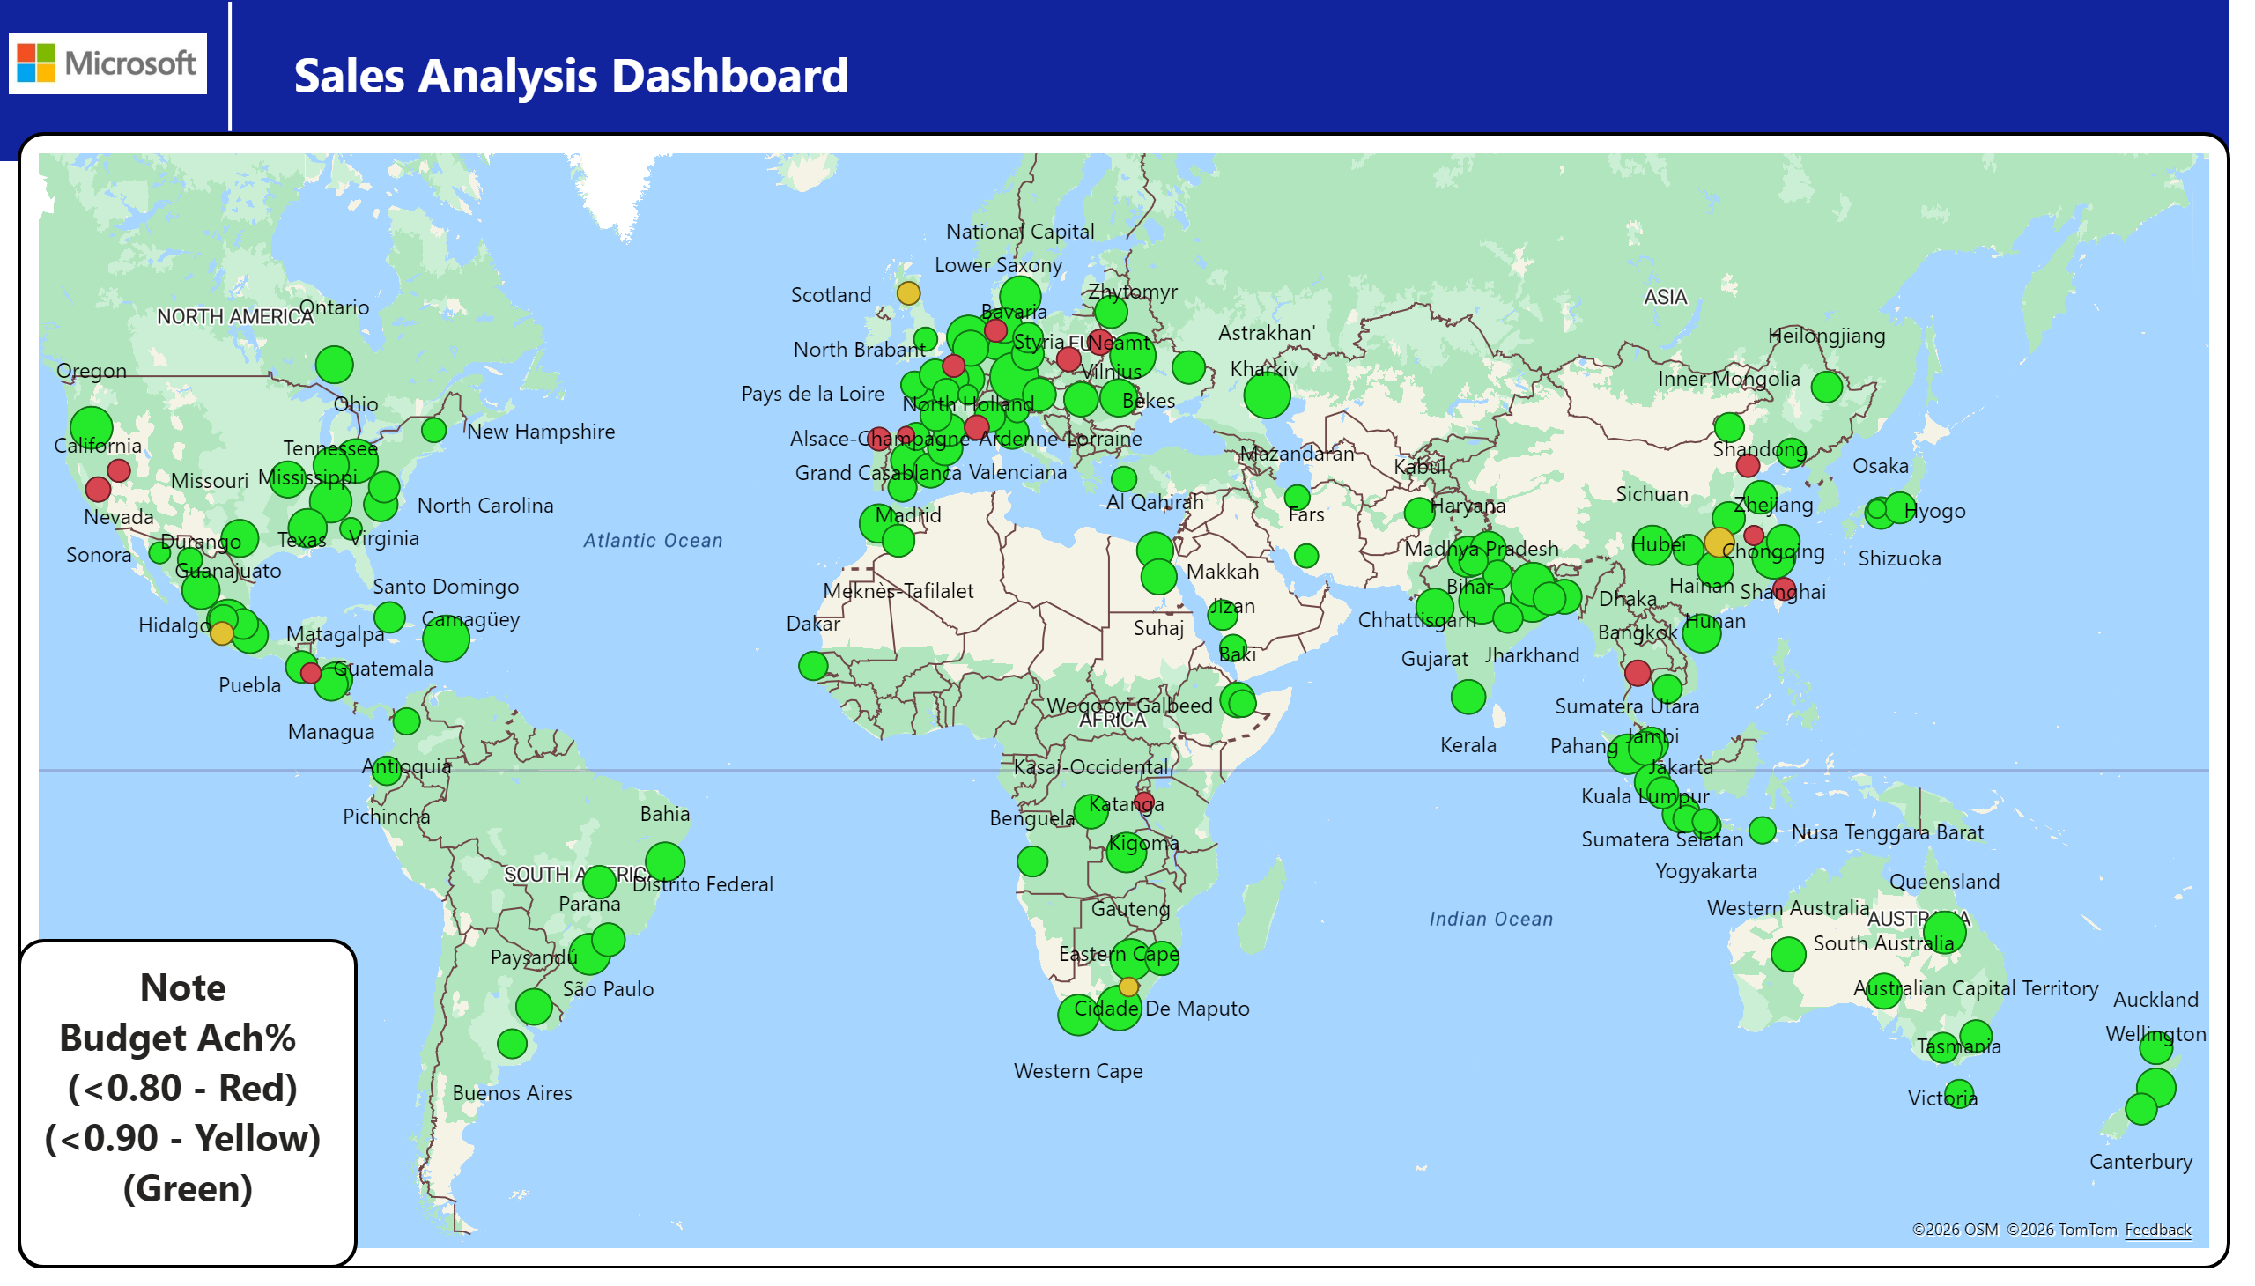
State wise Sale vs Budget YTD
Notes:
azureMap
No alt text provided
textbox
No alt text provided
image
No alt text provided
textbox
No alt text provided
shape
No alt text provided

Slide 4
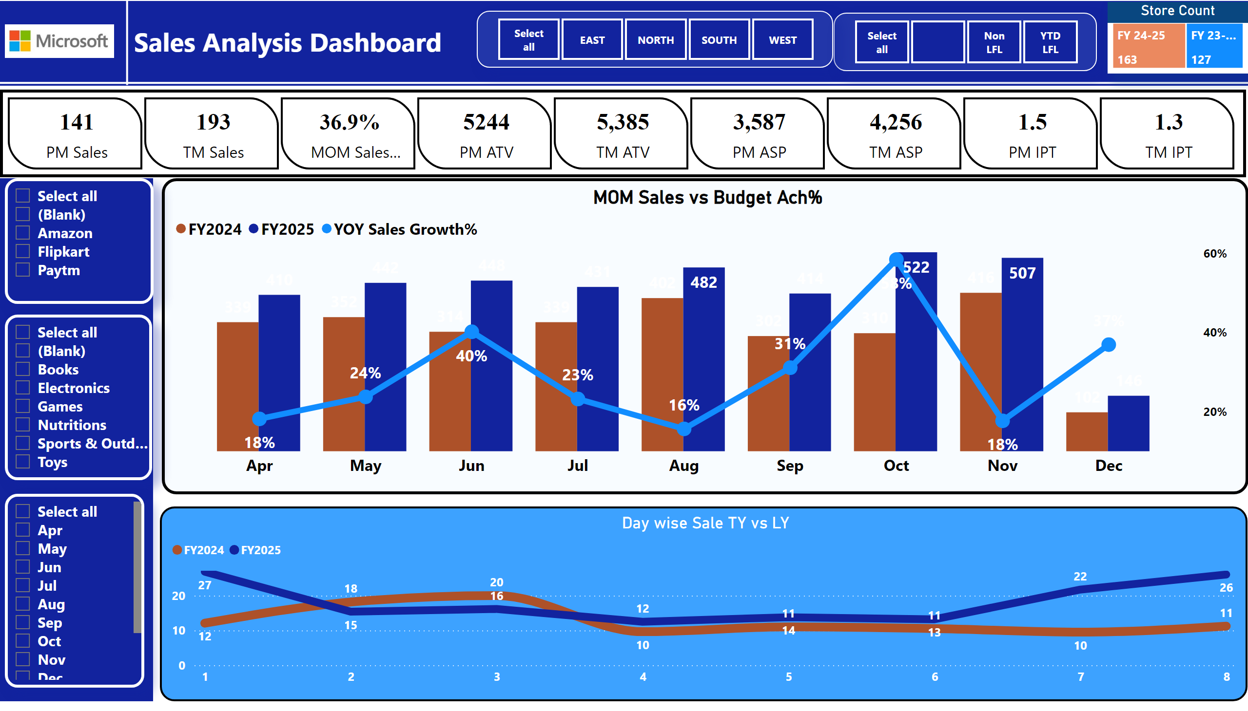
MOM Perfomence
Notes:
shape
No alt text provided
slicer
No alt text provided
Store Count
No alt text provided
slicer
No alt text provided
slicer
No alt text provided
slicer
No alt text provided
slicer
No alt text provided
MOM Sales vs Budget Ach%
No alt text provided
cardVisual
No alt text provided
textbox
No alt text provided
shape
No alt text provided
textbox
No alt text provided
Day wise Sale TY vs LY
No alt text provided
image
No alt text provided

Slide 5
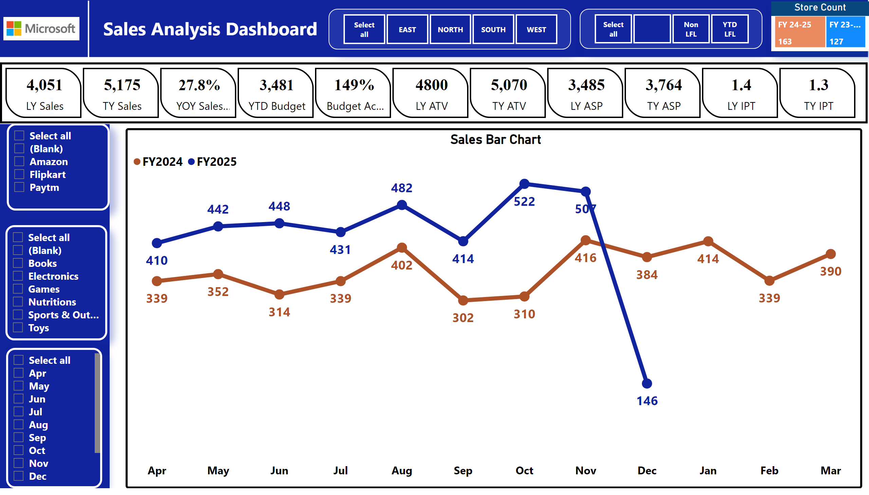
YOY & MOM Perfomrnce
Notes:
Sales Bar Chart
No alt text provided
shape
No alt text provided
slicer
No alt text provided
Store Count
No alt text provided
slicer
No alt text provided
slicer
No alt text provided
slicer
No alt text provided
slicer
No alt text provided
cardVisual
No alt text provided
textbox
No alt text provided
shape
No alt text provided
textbox
No alt text provided
image
No alt text provided

Slide 6
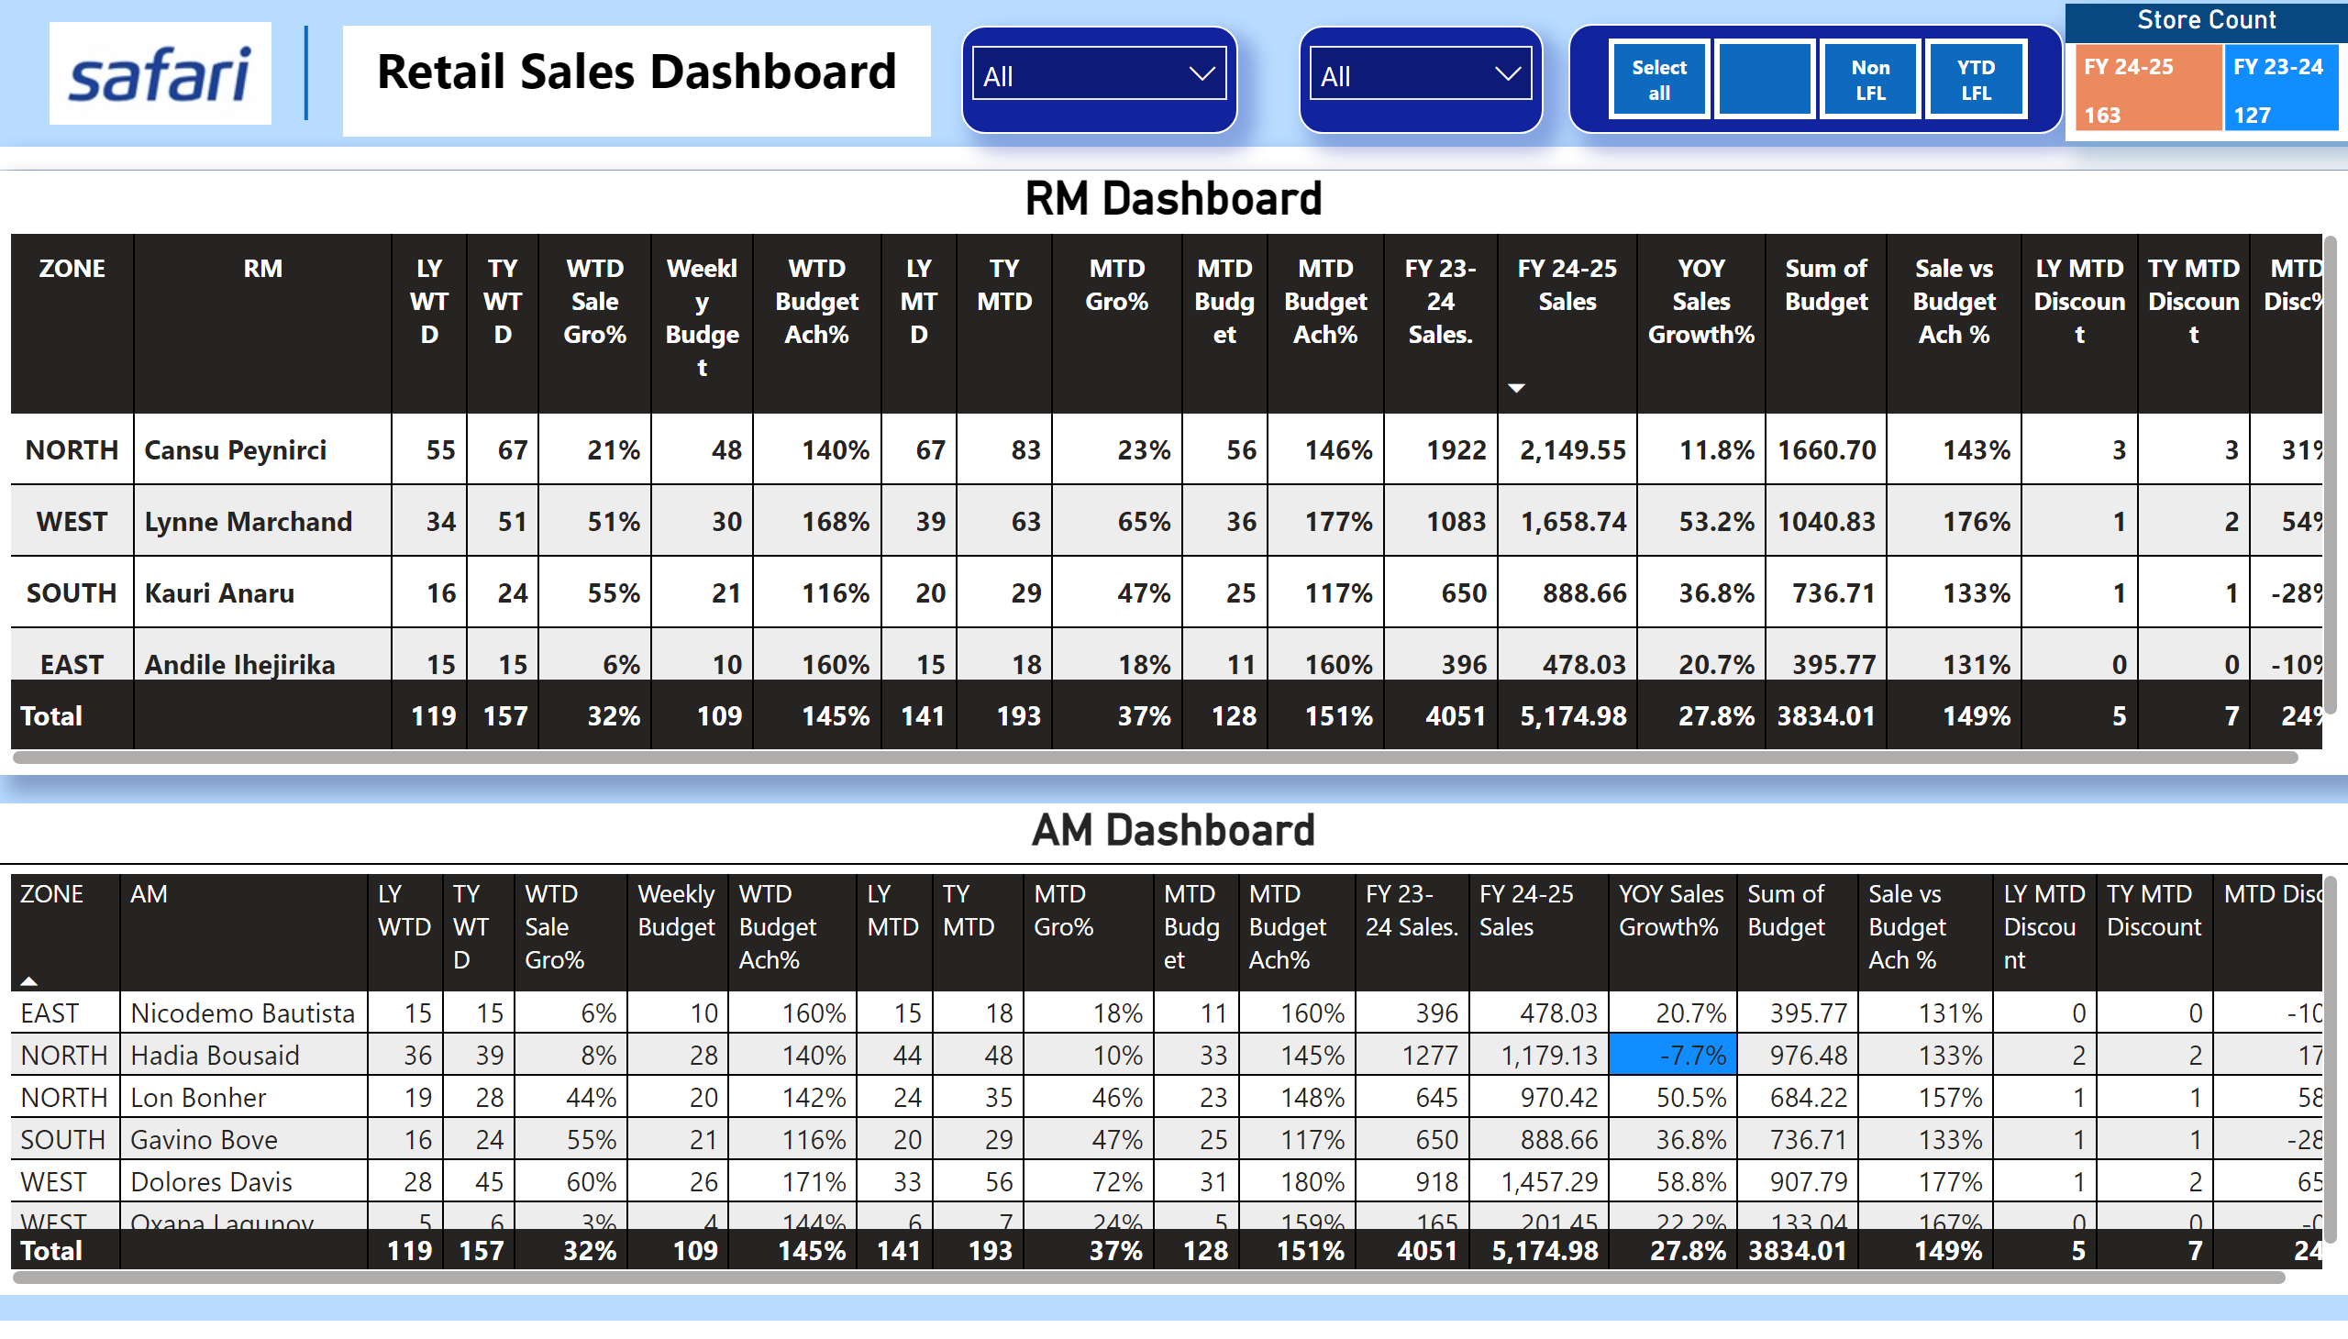
Zone & RM Dashboard
Notes:
textbox
No alt text provided
shape
No alt text provided
image
No alt text provided
shape
No alt text provided
slicer
No alt text provided
Store Count
No alt text provided
slicer
No alt text provided
slicer
No alt text provided
RM Dashboard
No alt text provided
AM Dashboard
No alt text provided

Slide 7
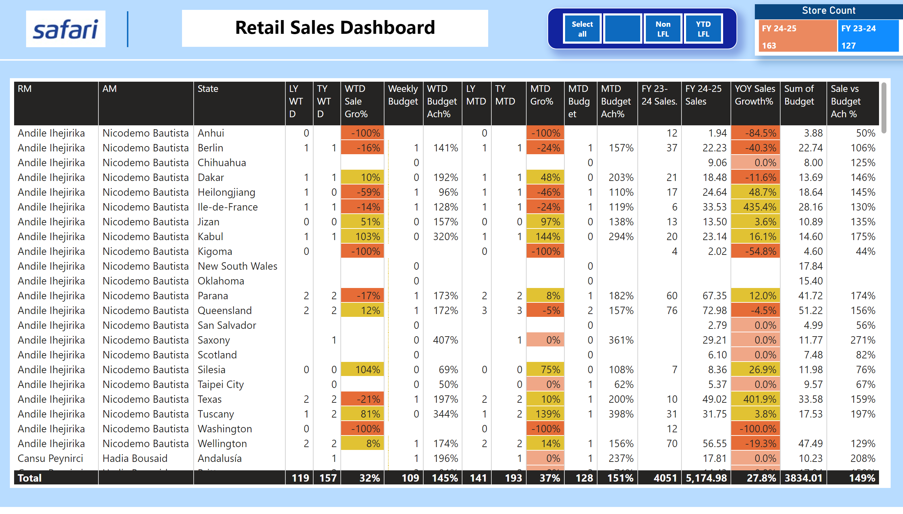
State wise Dashboard
Notes:
textbox
No alt text provided
shape
No alt text provided
image
No alt text provided
shape
No alt text provided
Store Count
No alt text provided
slicer
No alt text provided
tableEx
No alt text provided

Slide 8
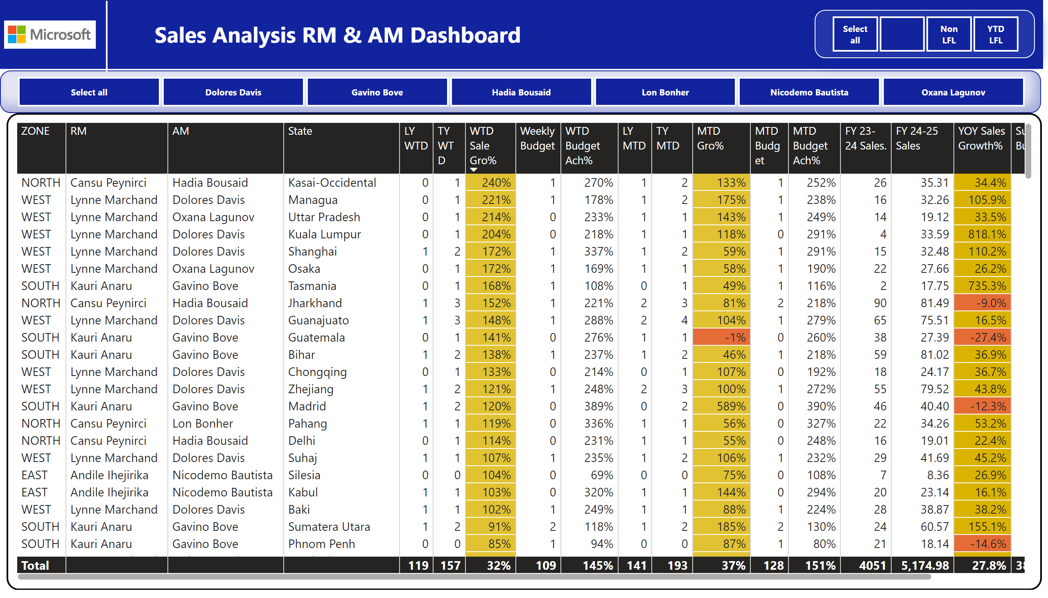
Store wise Dashboard
Notes:
shape
No alt text provided
slicer
No alt text provided
tableEx
No alt text provided
slicer
No alt text provided
textbox
No alt text provided
image
No alt text provided
shape
No alt text provided

Slide 9
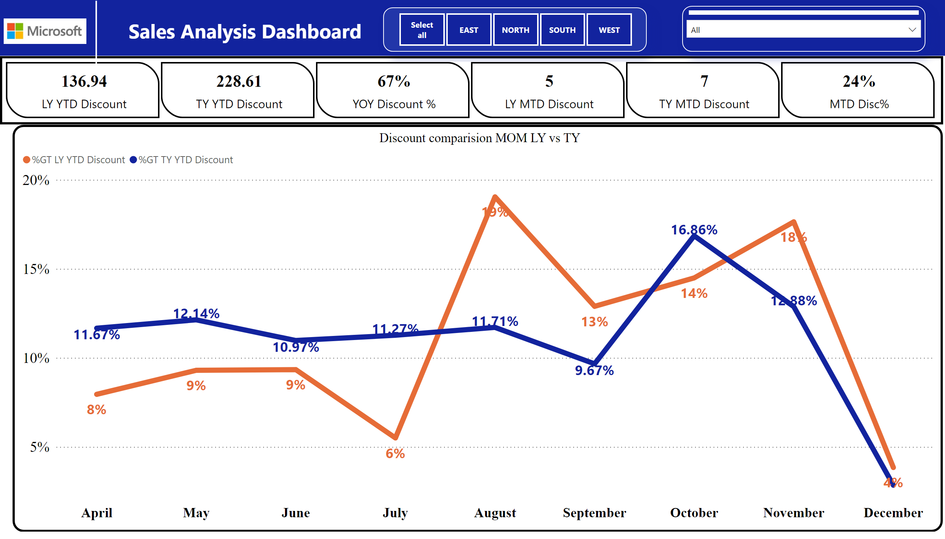
Discount Analysis
Notes:
slicer
No alt text provided
Discount comparision MOM LY vs TY
No alt text provided
cardVisual
No alt text provided
slicer
No alt text provided
textbox
No alt text provided
shape
No alt text provided
image
No alt text provided

Slide 10
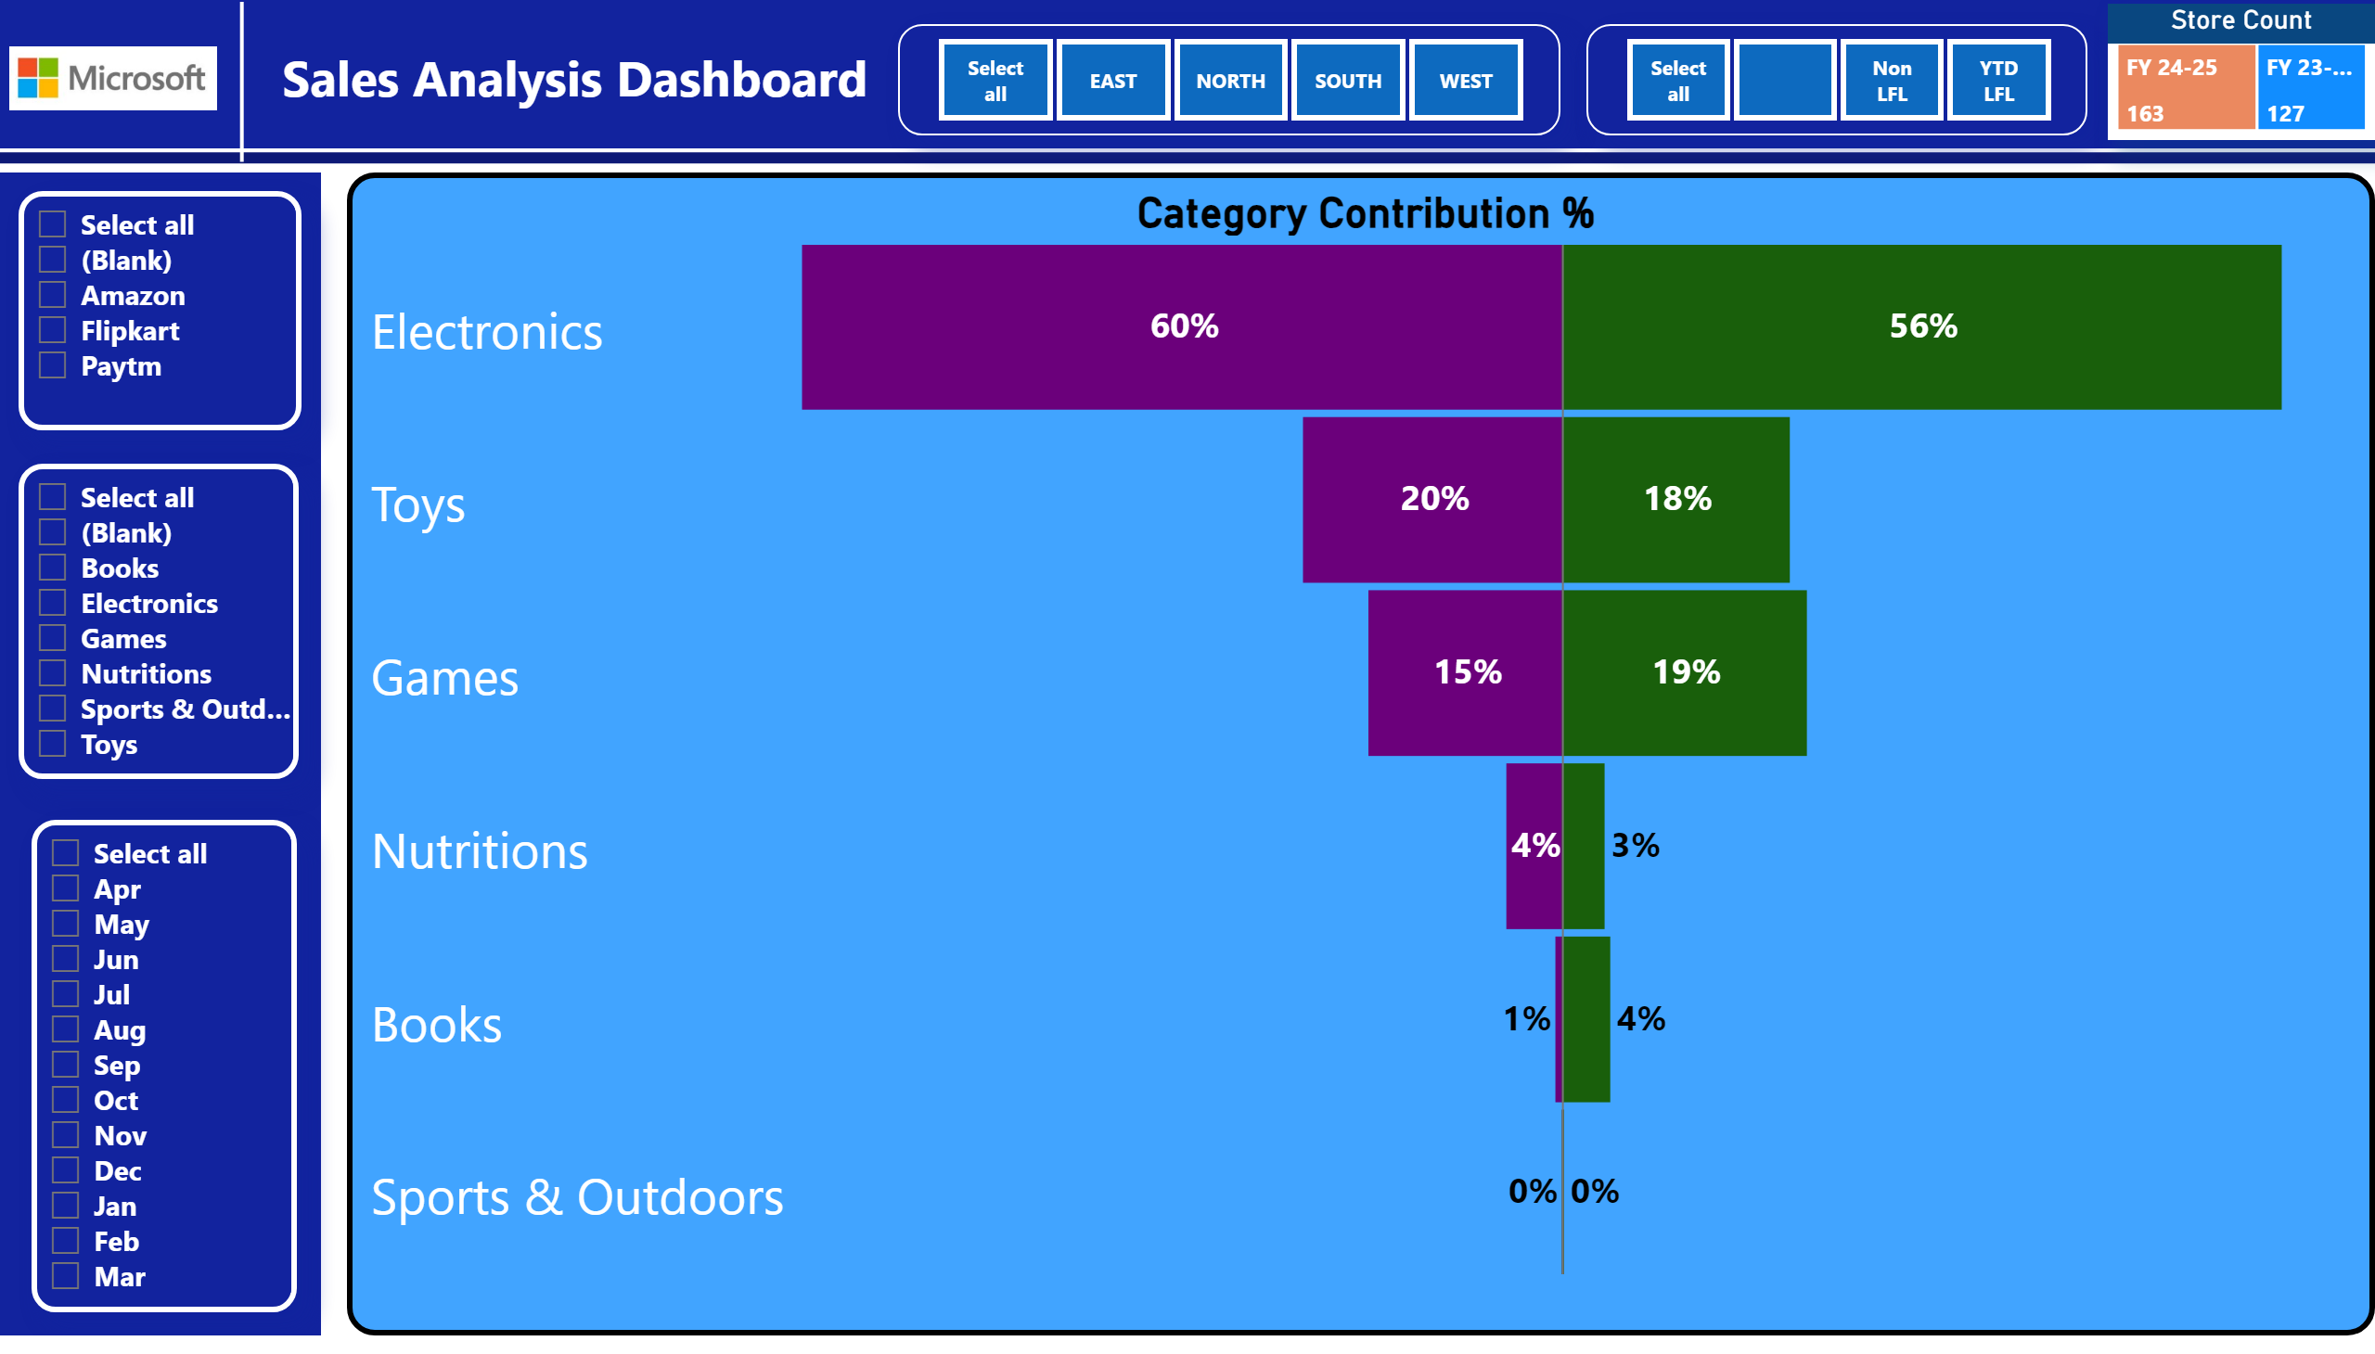
Category Perfomrnce
Notes:
Category Contribution %
No alt text provided
shape
No alt text provided
slicer
No alt text provided
slicer
No alt text provided
Store Count
No alt text provided
slicer
No alt text provided
slicer
No alt text provided
slicer
No alt text provided
textbox
No alt text provided
shape
No alt text provided
textbox
No alt text provided
image
No alt text provided

Slide 11
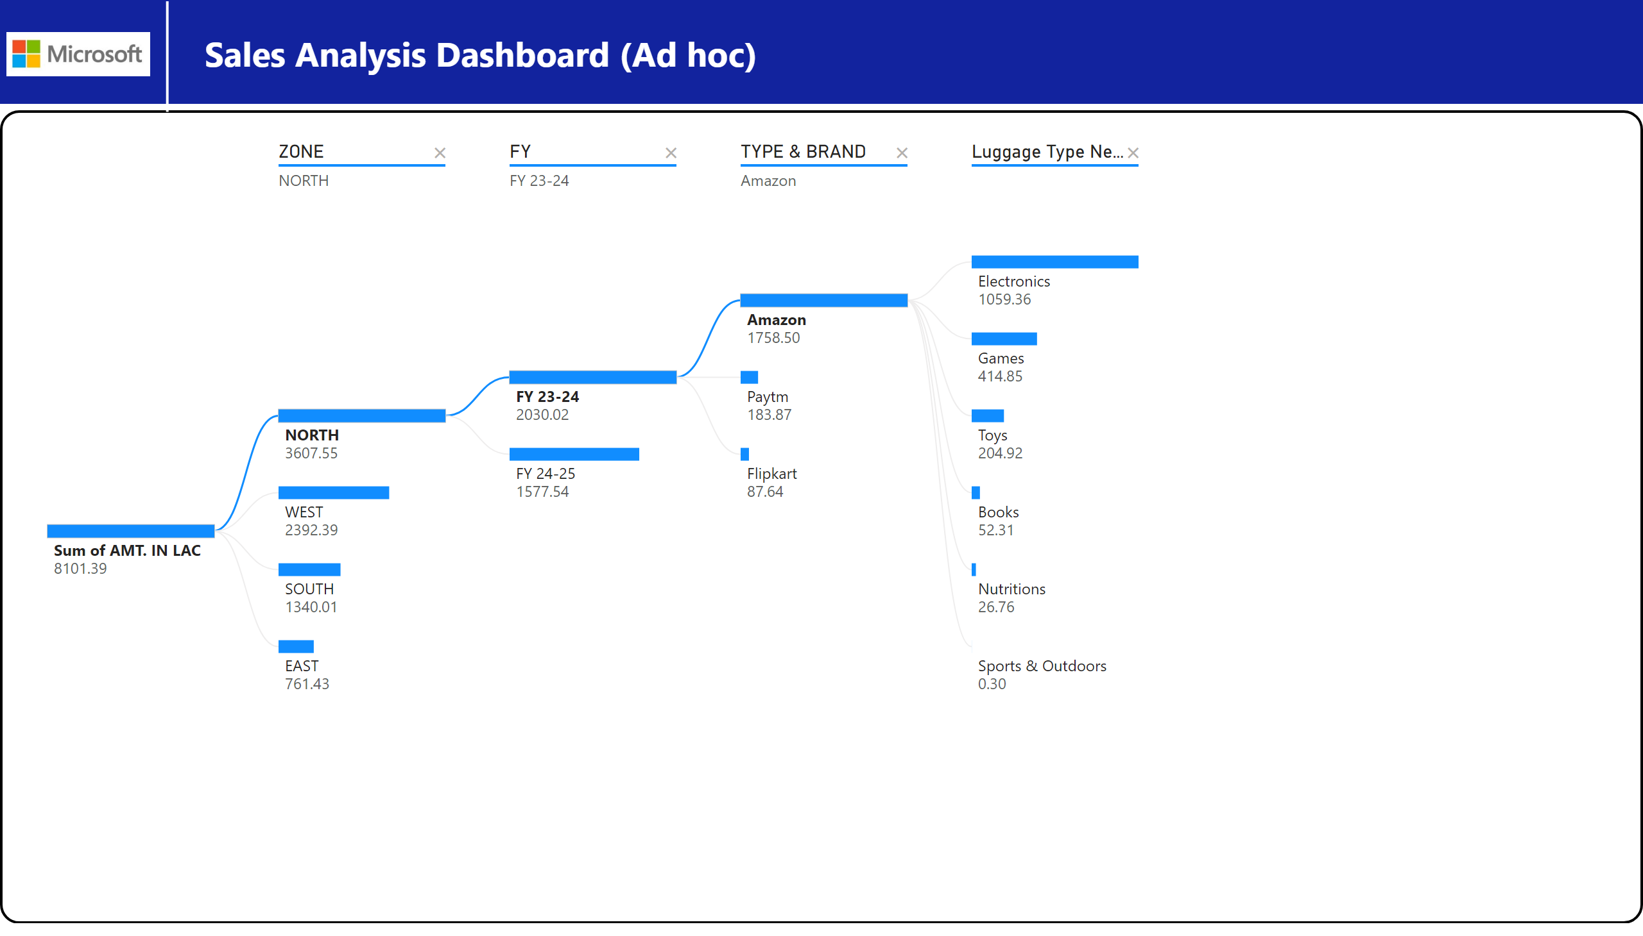
Ad hoc Analysis
Notes:
shape
No alt text provided
decompositionTreeVisual
No alt text provided
textbox
No alt text provided
shape
No alt text provided
image
No alt text provided

